Slide 1
Python Course for Physicists (And everyone else!) Chunk 7: Imports
By Jonathan Bollig
09.10.2025

Slide 2
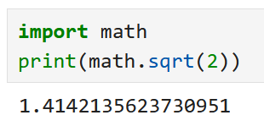
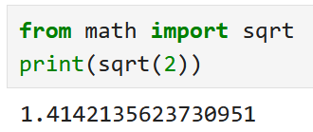
Live Coding: Being Lazy - Let Others Code
Imports allow you to use code, that others have programmed.
„Package“ of code: module
To use a module:
Direct use of functions:

Slide 3
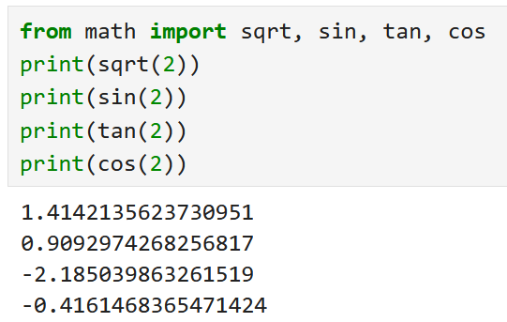
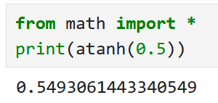
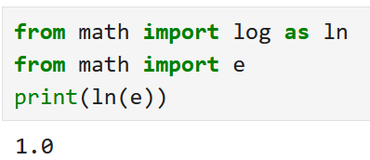
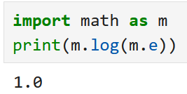
Live Coding: More options:
Import multiple functions:
Import all:
→ Not recommended
Rename on import

Slide 4
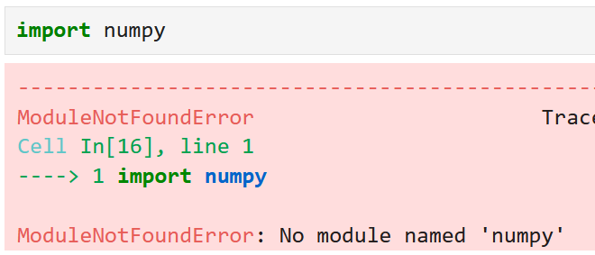
Built-in Modules → External Modules
Math is a built-in module in python
Users upload their modules for use by other people
For example: numpy ≙ numerical python
External modules have to be installed in the command line → Otherwise:
Notes:
Note: Anaconda Manager works as well, but it’s better to do it in the command line

Slide 5
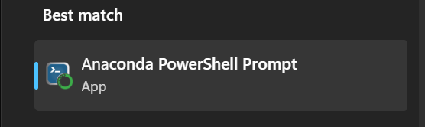
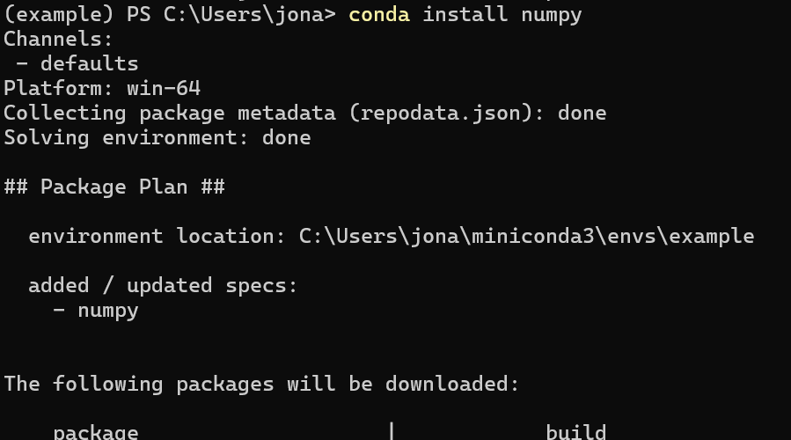
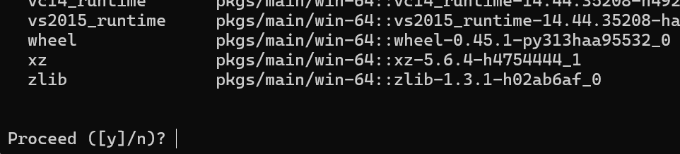
Tutorial: Installing Modules using Conda
Open “Anaconda Powershell Prompt”
Enter “conda install numpy”
Type „y“ + Enter to proceed
In your case it will show “base” instead of “example”

Slide 6
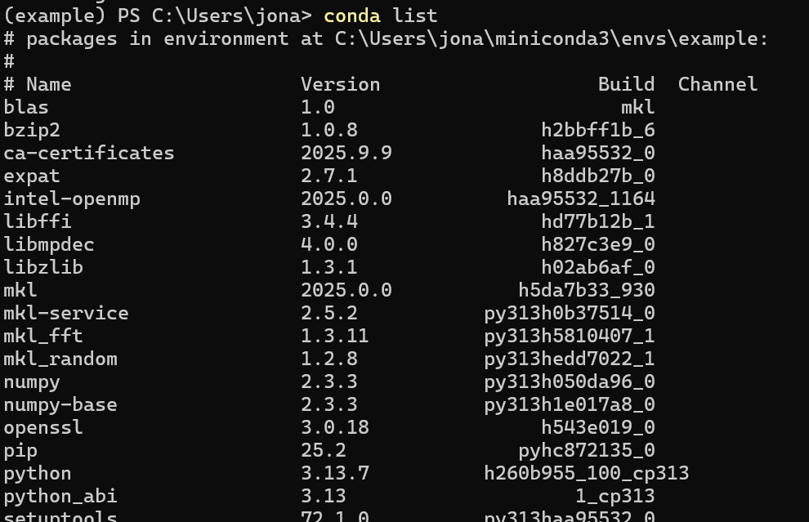
Optional: Check installation with “conda list”
“conda list” lists all installed packages
When installing numpy a lot of other packages get installed as well (dependencies)
Note: “conda” and “pip” do very similar things → mostly interchangeable (Relevant when googling)

Slide 7
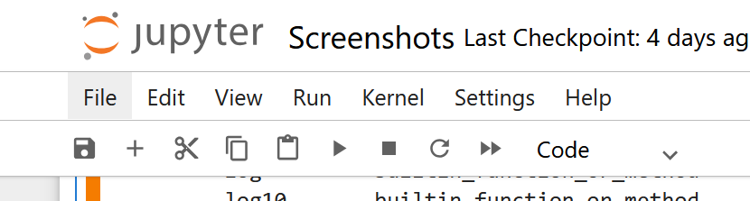

Using installed modules
Restart kernel:
Import works now:

Slide 8
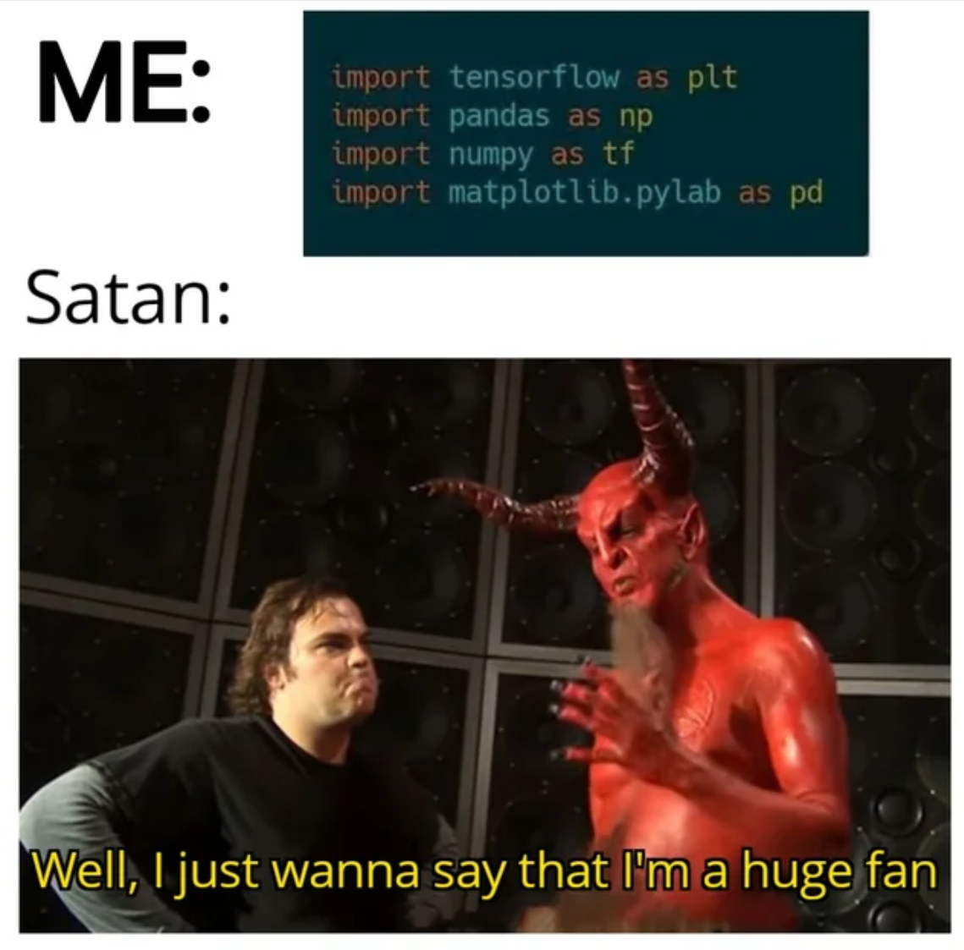
Good Luck with your Tasks ☺
[https://www.reddit.com/r/ProgrammerHumor/comments/o3zjp4/thats_the_evilest_thing_i_can_imagine/]

